Slide 1
Randomisation to Control – Wages and Tait (RtC-WT): An extension to the Wages and Tait trial design

Slide 2
Adaptive phase I/II trial designs
Aim:
To obtain the optimal biological dose (OBD)
Uses both efficacy and toxicity outcomes
Examples:
EffTox
Wages & Tait (WT)
Notes:
In Phase I dose-finding trials the MTD is usually determined under the cytotoxic assumption, which assumes the most toxic dose is the most efficacious. Subsequent phase II trials aim to assess the efficacy of the treatment at the MTD, which is usually conducted independently so the ability to share information across the phases is somewhat lost.
For treatments like chemotherapy that cytotoxic assumption holds. However, the emergence of modern treatment such as immunotherapies and molecular targeted agents challenges this paradigm. The monotonice assumption of dose-toxicity and dose-efficacy may not hold for these treatments. Generally these treatments may also be less toxic with the most efficacious dose occurring below the MTD. So instead of trying to find a MTD, the goal would be to determine the optimal biological dose. The definition of OBD may change depending on circumstance it may be the dose that provides the maximum probability of efficacy with toxicity under a certain level or a it may be a beneficial trade off between toxicity and efficacy.
Some examples of these designs are EffTox and Wages and Tait.

Slide 3
The Wages and Tait Design
Toxicity modelling
Utilises a CRM approach to establish DLT probabilities
Efficacy modelling
Bayesian approach using multiple skeletons
Prior probabilities are assigned to each skeleton
Posterior probabilities used to determine which skeleton will be modelled
Notes:
We’re focusing on Wages and Tait.
In this design toxicity is modelled in a similar manner to the CRM. We also model efficacy using a similar approach. In this case however we have multiple skeletons which represent a range of different efficacy curves. We can then assign prior probabilities to these skeletons/models which represent the plausibility of each efficacy curve. Once we recruit patients and have data to evaluate, we can generate posterior probabilities for these plausibilities. We then use the skeleton with the highest posterior probability to then model efficacy.

Slide 4
The Wages and Tait Design
Adaptive Randomisation Phase
Dose randomly selected from a set of admissible doses
Randomisation probabilities are proportional to estimated efficacy
Maximisation Phase
Dose from the admissible set with the highest probability of efficacy
Notes:
This design operates in two phases. The first being the adaptive randomization phase. Here we determine, using the toxicity modelling, which of our doses are safe. This is done in a similar way to the CRM i.e we set a target toxicity rate and then all dose levels below that have toxicity probabilities below that level are considered safe. This is our set of admissible doses. We then determine the efficacy probabilities using the efficacy modelling previously mentioned. Those probabilities are then in turn used to generate randomization probabilities to doses in the admissible set. A dose is then selected based on those probabilities.
In the maximization phase we just select the dose with the highest probability of efficacy.
Depending on the sample size we can alter how big the adaptive randomization phase and maximization phases are. Typically this is set at 50%.

Slide 5
Adding a Control Arm
Rationale
Adaptive designs don’t replace the need for randomised Phase II trial
Example:
Investigation of a standard of care treatment in combination with an experimental treatment
Notes:
Seamless adaptive phase I/II designs ultimately aim to replace the need of conducting phase I and Phase II trials independently. However, a lot of the methodology currently only focuses on using efficacy to determine the OBD. Once this is done there may still be a need to collect more data on efficacy in a randomized phase II setting depending on treatment. So, whist useful these designs don’t replace the need for a randomized phase II trial.
Due to the adaptive randomization component in the wages and tait design we hope to leverage that to allow us to recruit patients to a control dose. This will also allow us to make inferences on the efficacy of treatment compared directly to a control dose.
One example where this could be used is when investigating a standard of care dose with a known toxicity and efficacy profile in combination with an experimental treatment. The first dose-level would be the standard of care then subsequent dose levels would be more of the experimental treatment and we’d be able to determine how efficacy and toxicity increase/decrease with the doses of experimental treatment.

Slide 6
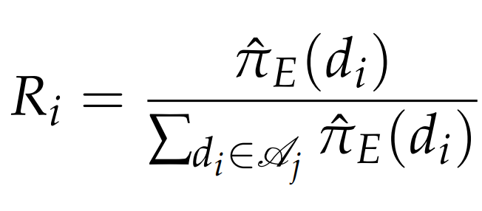
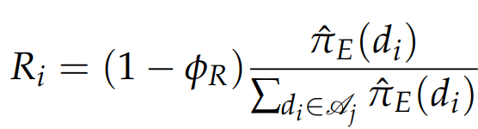

Application
Standard Wages and Tait
RtC-WT
Notes:
The actual implementation is relatively simple. In the standard wages and tait the formula here is used to determine the randomization probabilities. So Ri is the randomization probability for the i’th dose. This is calculated by taking the estimated probability of efficacy for the dose and dividing it by the sum of all the estimated probabilities of efficacy for all doses in the admissible set. For randomize-to control wages and tait, we specify the lowest dose level as being the control dose and we specify the probability of randomizing to that dose up front. So here phi R can take any value between 0 and 1. We then scale the randomization probabilities for the remaining doses based on this phi parameter.
This modification only affects the adaptive randomization phase of the trial. Once we switch to the maximization phase dose-levels are allocated based on the highest efficacy. So, we need to tune the parmater phi R and the size of the adaptive randomization phase to ensure we get enough patients in the control dose whilst also maintain reasonable operating characteristics.

Slide 7
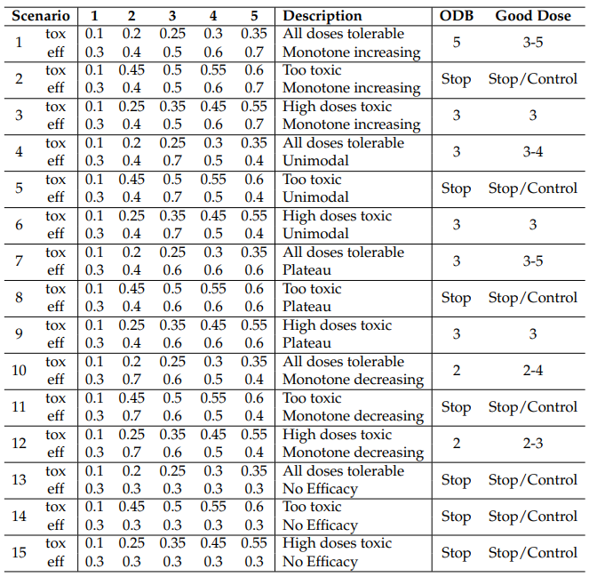
Simulations
Notes:
In order to assess the design, we ran simulations across 15 different scenarios. These scenarios look at 5 different efficacy curves in combination with 3 different toxicity curves. We also detail in each scenario what the OBD would be as well as what would be considered good doses. Good doses include the OBD as well as other doses which are safe but may necessarily not be the most efficacious.

Slide 8
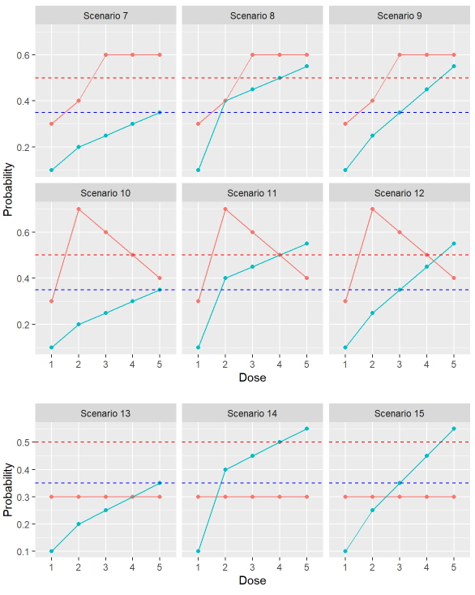
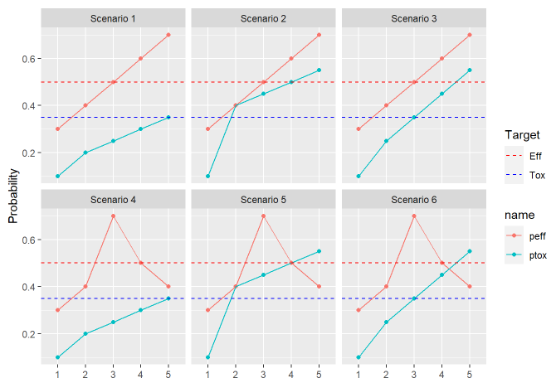
Notes:
These are all the scenarios visualiesed. So we have 5 dose-levels with the first dose-level being the control dose. We have a target toxicity rate of 35 % and efficacy rate of 50%. So we’re looking for a dose which has at least 50% efficacy rate with no mare than a 35% toxicity rate. In all these scenarios the control dose, dose-level 1 has 10% toxicity rate and 30% efficacy rate.

Slide 9
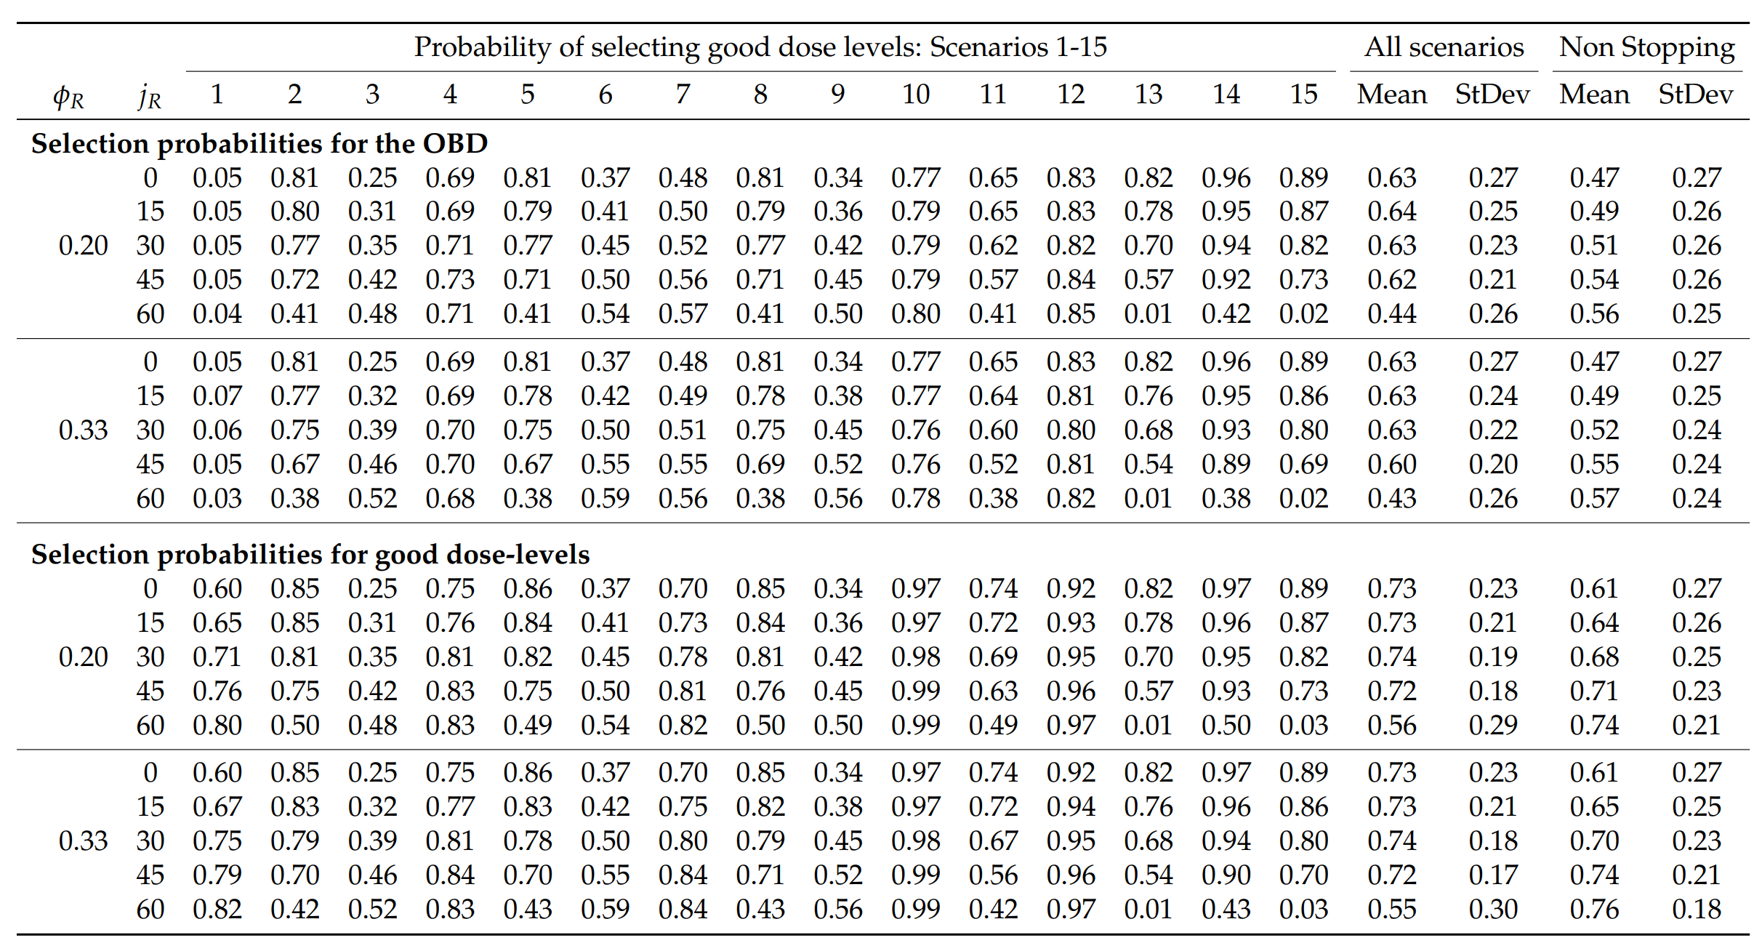
Simulation - Results
Notes:
We simulated 10000 trials for each scenario. In each trial we had those 5 dose-levels and were aiming to recruit 60 patients. We included stopping rules to stop if the lowest experimental dose was too toxic.

Slide 10
Alternative Designs
Standard Wages and Tait:
Just include the control treatment as the lowest dose-level
Two-Arm approach:
Patients randomised up-front

Slide 11
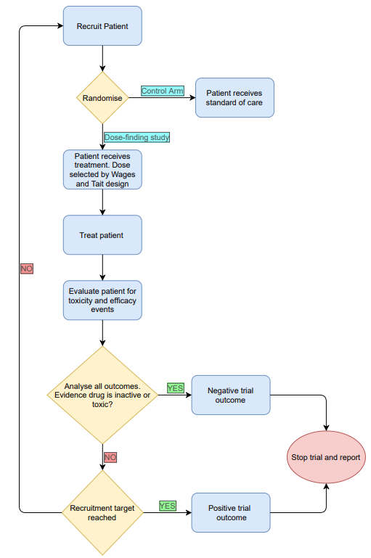
Two-Arm Approach

Slide 12
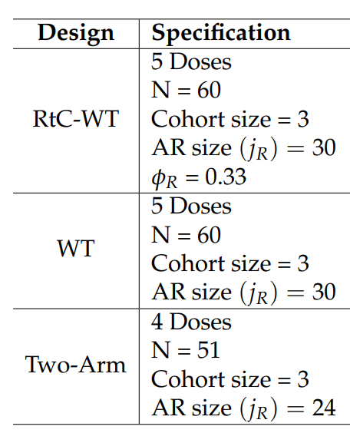
Simulations

Slide 13
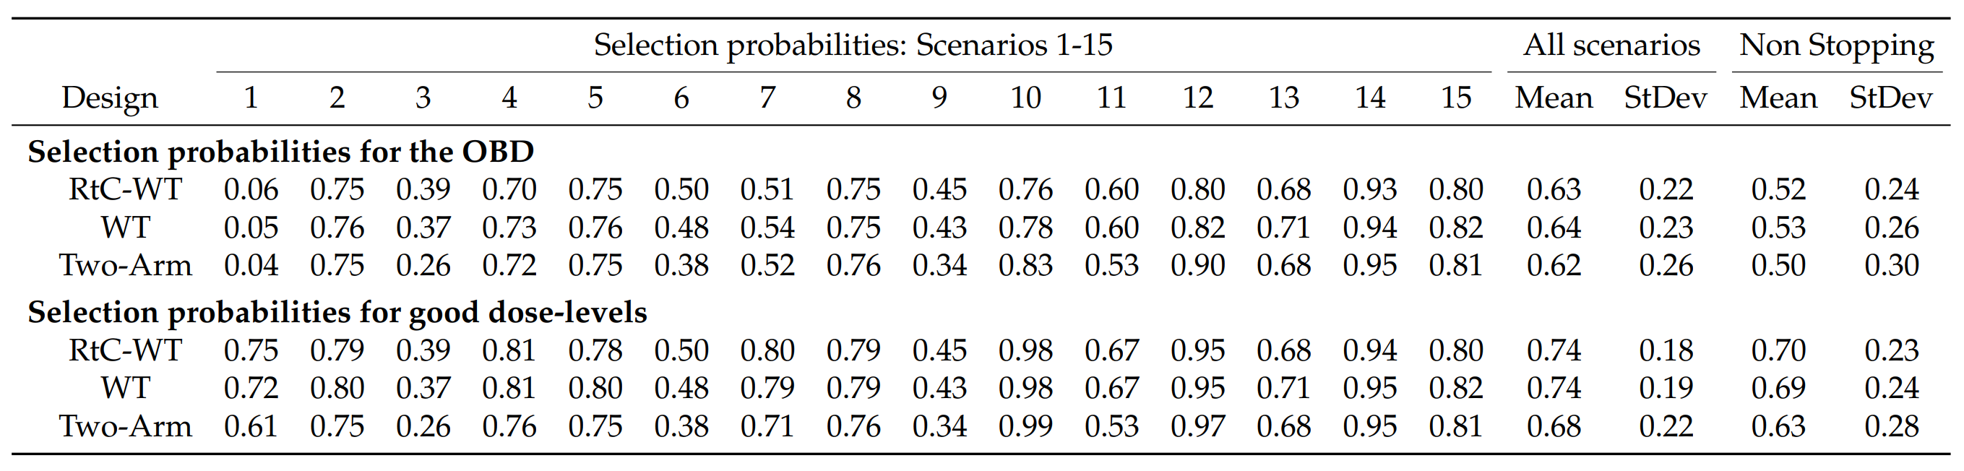
Simulations – Results

Slide 14
Simulations – Results

Slide 15
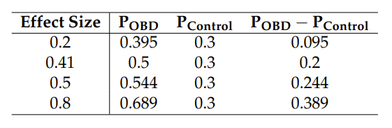
Efficiency of an Efficacy test

Slide 16
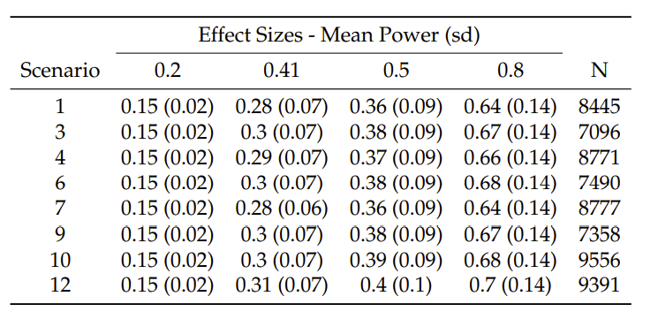
Efficiency of an Efficacy test

Slide 17
Conclusion
RtC-WT maintains reasonable operating characteristics when randomising patients to a control dose
We investigated a variety of parametrisations
We made comparisons to alternative designs
The aim of this design is to replace the need for a randomised Phase II
Lose some benefits of traditional randomisation
Need additional patients at both control arm and OBD to make definitive statements about efficacy
Notes:
No other alternative design has the same aim as RtC-WT

